Slide 1
Module 1
Basic Electricity

Slide 2
Subtopic
Units of Measures
Ohms Law
Power Equation
Voltage, Current and Resistance
Electro monogenism

Slide 3
Subtopic
Units of Measures
Ohms Law
Power Equation
Voltage, Current and Resistance
Electro monogenism

Slide 4

Electromagnetic Fields
Electromagnetic fields are formed by the forces created by the earth’s magnetic field

Slide 5
Magnetic Dipoles
Permanent magnets are created by aligning the atoms in a crystalline structure such that the north and south polarity align with the earth magnetic poles

Slide 6
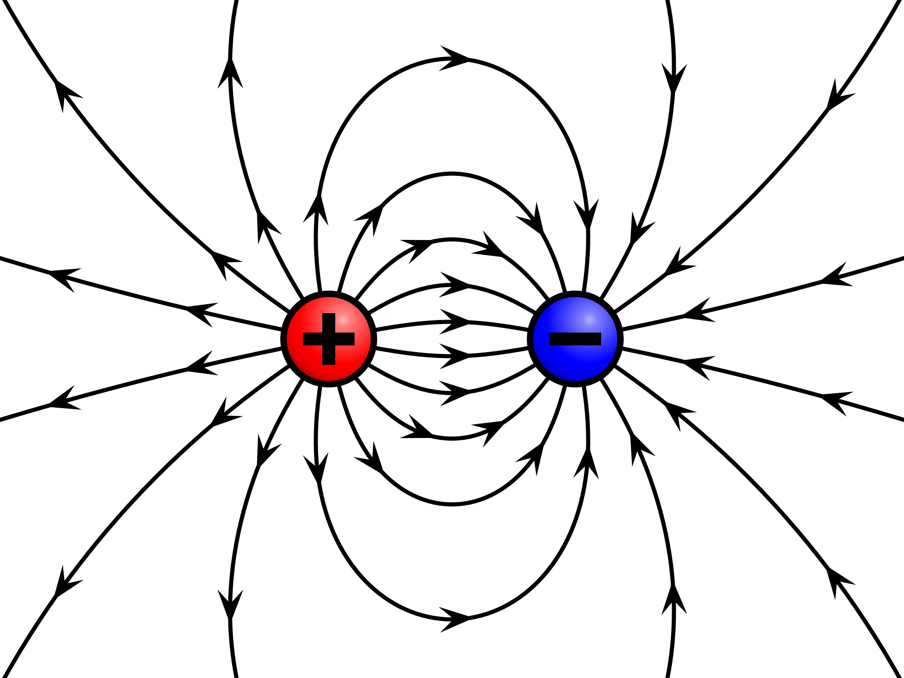
Electrostatic Fields
Electrostatic fields are formed by the forces created between positively and negatively charged particles

Slide 7
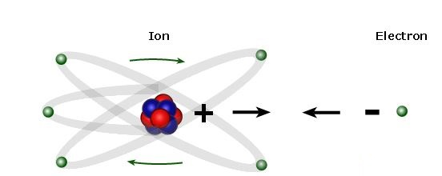
Generation of static charge
When an electron is stripped away from an atom the atom becomes positively charged
The electron becomes negatively charged
Lightning is caused by an differential between fields

Slide 8
The Coulomb
Electric charge is measured in coulombs
1 coulomb = 6.25x10¹⁸ Charge Carriers

Slide 9
Voltage vs Current
Voltage ( symbolized V) is defined as the amount of energy required to move a unit of electrical charge from one place to another ( potential, energy/unit of charge).
Measured in Volts
Current (symbolized with an I) is the amount of charge carries passing a specific point on a circuit at any given time. The unit of current is called the ampere (abbreviated amp or A).
Measured in Amps
Potential Energy vs Kinetic Energy

Slide 10
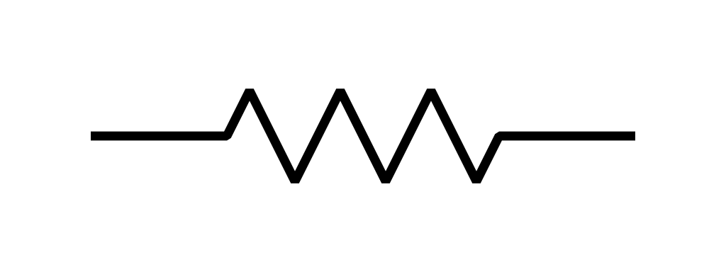
RESISTANCE
Resistance is the term used to describe a reduction in current flow. All conductors intrinsically have some resistance built in. ( the actual cause for the resistance can be a number of things: electron- conducting nature of the material, external heating, impurities in the conducting medium, etc.) in electronics, devices called resistor are specifically designed to resist current.
The symbol of resistor used in electronics is shown below:
R is called the resistance and is given in units of volts per ampere, or ohms (abbreviated- Ω ).
1 Ω = 1V / A

Slide 11
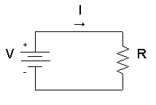
Ohm’s Law
Ohm’s Law says that a voltage difference V across a resistor R will cause a current I = V/R to flow through it.
For Example, if you know R and and V, you plug these into Ohm’s law to find I. Likewise, if you know R and I, you can rearrange the Ohm’s Law equation to find V. If you know V and I you can again rearrange the equation to find R.
V = I ⨉ R
I =
R =

Slide 12
Power equation
Power is measured in watts, symbolized by the letter “ W ”.
P = I x V
P =
P = R ⨉

Slide 13
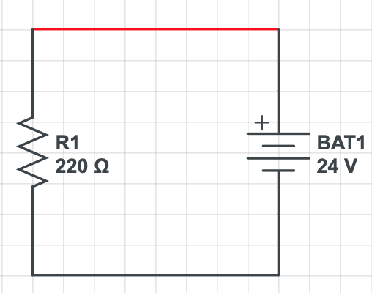
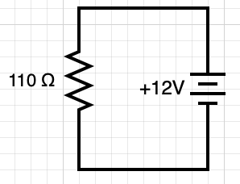
Exercises:
1) Calculate the amount of power dissipated in 220 ohm resistor connected across a 24 VDC power supply.
2) A 110 ohm resistor is connected across a 12 volt battery. Calculate the current ( I ).

